Slide 1
Participant Portal
Paperless Grant Management
Peter HÄRTWICH
DG RTD

Slide 2
Principles
Participant Portal as single gateway for all exchanges
Single sign-on: One user name and password (ECAS) gives access to all functions
Personalised web space after login: you see all your assets related to your proposals, grants, expert account…
Transparency: Everybody having a role on a project sees the full archive of all exchanges and documents
Flexible management of roles and access rights: most roles to be assigned/revoked by the Consortium itself
Digital sealing of documents; digital signatures replacing paper signatures

Slide 3
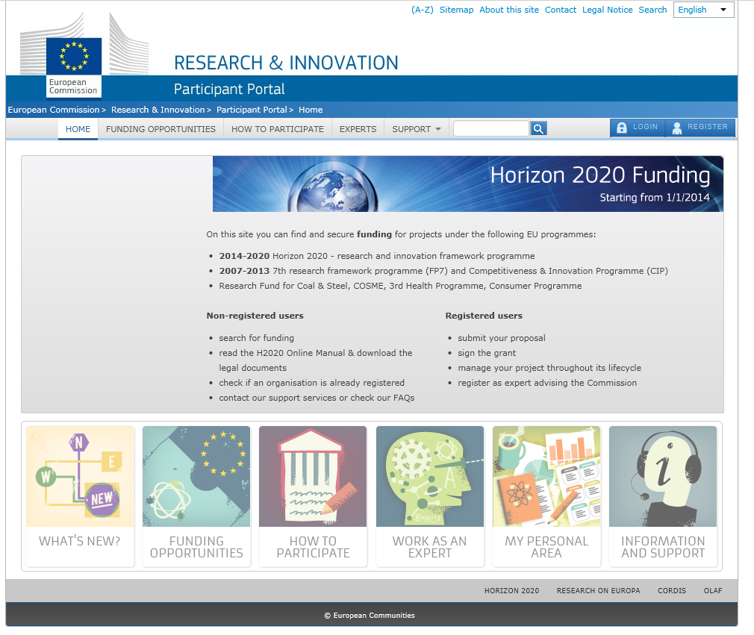
Live demo

Slide 4
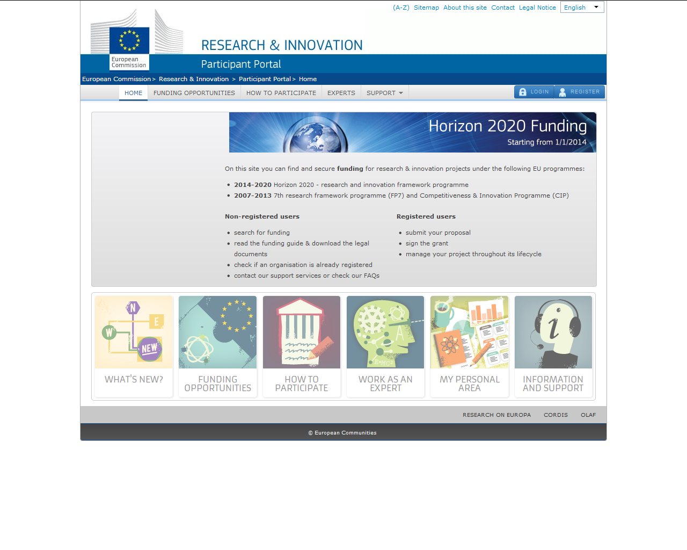
Public access
ECAS login or registration

Slide 5
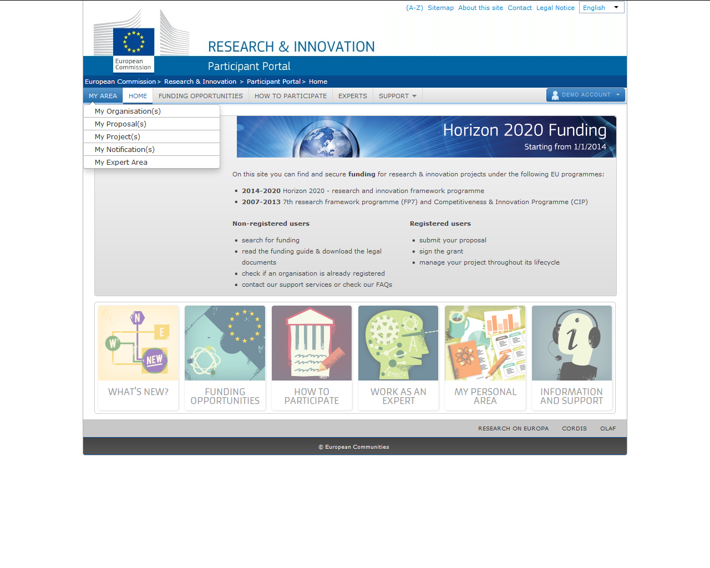
Personalised access
to the IT tools
Personalised access
to the user account

Slide 6

The Identity and Access Management (IAM)
The Identity and Access Management allows us to define
and/or manage changes of access rights of users
of the Participant Portal.
It gives a personalised and secure access to the different services of the Participant Portal.
Minimum involvement by the Commission/Agency staff allowing
for flexibility in the online management of the consortium.
Any change in the roles of the users is saved to allow
a monitoring & tracking service.

Slide 7

Personalised services
The Participant Portal allows each user to have access to a personalised space, based on 3 main elements:
Each user is supposed to have a unique ECAS account,
which is the unique identifier for persons
(linked to their professional email address).
Each ECAS account is linked to one (or more) PIC number(s) to
the unique identifier of the organisation.
Each ECAS account is linked to all the roles
that the user has in projects
and/or organisations through IAM.
One user can have as many roles
as necessary.
999999999
PCoCo
CoCo
PaCo
TaMa
TeMe
LEAR
AccAd
LSIGN
FSIGN

Slide 8
Roles - Nomenclature
Organisation roles
Project roles
Primary Coordinator Contact
PCoCo
Legal Entity Appointed Representative
Coordinator Contact
Legal Signatory
CoCo
LEAR
LSIGN
Participant Contact
PaCo
Account Administrator
Financial Signatory
AccAd
FSIGN
Task Manager
TaMa
Team Member
TeMe

Slide 9
Roles and access rights (organisation)
Role | Read | Write/Save | Assign/Revoke AcAds | Assign/Revoke LSIGNs and FSIGNs
LEAR
AcAd |  |  | x
LSIGN |  | x | x | x
FSIGN |  | x | x | x

Slide 10
Roles and access rights (project)
Role | Read | Write/Save | Submit to Coord. | Submit to COM | SIGN GA | SIGN Fin Stat. | Assign/revoke access
CoCo |  |  |  |  | x | x
PaCo |  |  |  | x | x | x
TaMa |  |  | x | x | x | x | x
TeMe |  | x | x | x | x | x | x
PLSIGN |  |  | x | x |  | x | x
PFSIGN |  |  | x | x | x |  | x

Slide 11
How to acquire roles/access?
Access rights are managed by the organisations and consortia themselves (two exceptions)
Self-registrant: the person who registers the PIC
LEAR: paper process, by the legal representative of the organisation, approval by COM
Account Administrator: by LEAR
LSIGN, FSIGN: by LEAR/Account Administrator
Primary CoCo: from proposal, change via COM project officer
CoCo: from proposal or by another CoCo
Participant Contact, Team Member: from proposal or by CoCo, other PaCo
Task Manager: by CoCo or PaCo
PLSIGN, PFSIGN: chosen from list of LSIGNs and FSIGNs by CoCo or PaCo

Slide 12
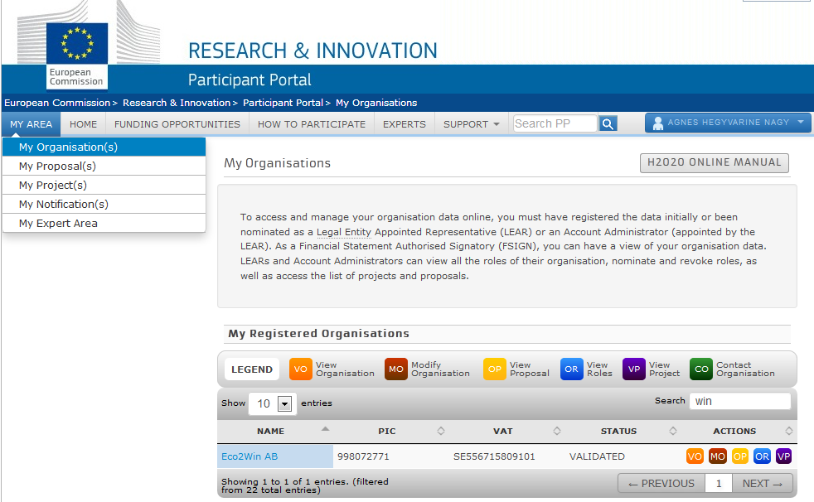
Roles for Organisations
Functions for LEARs:
View or modify your organisation's data.
View all roles linked to the PIC.
View list of proposals or projects.
Functions for self-registrants:
View or modify your organisation's data.
NAME
99999999
VAT no.

Slide 13
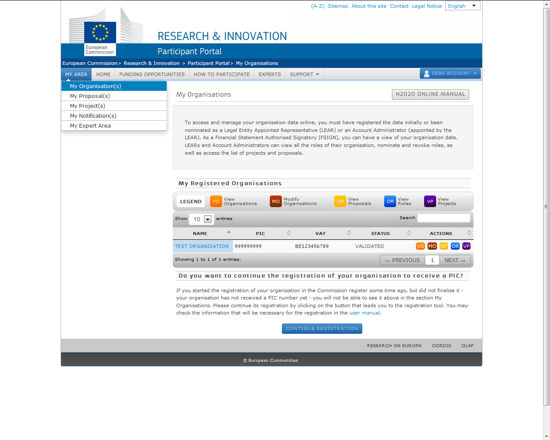
Organisation roles can be granted/revoked
in the "My Organisations" section,
through the blue "OR (Organisation Roles)" icon

Slide 14
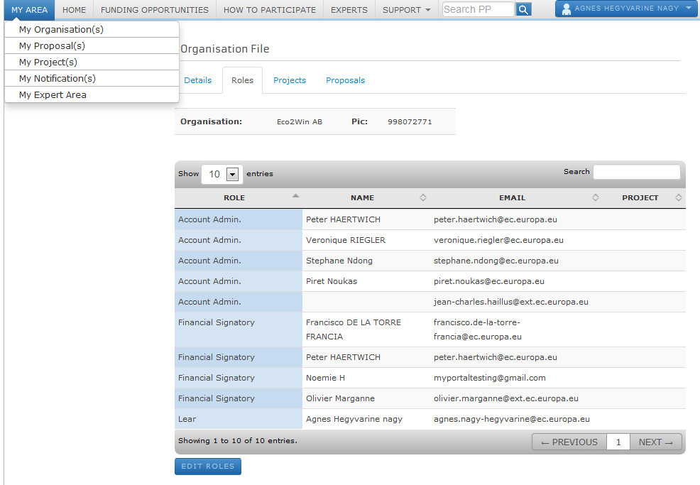
NAME
99999999
List of names and e-mails of contacts linked to the PIC number of the organisation.
Edit roles:
Add roles or revoke existing rights by identifying the
e-mail/name of a person.

Slide 15
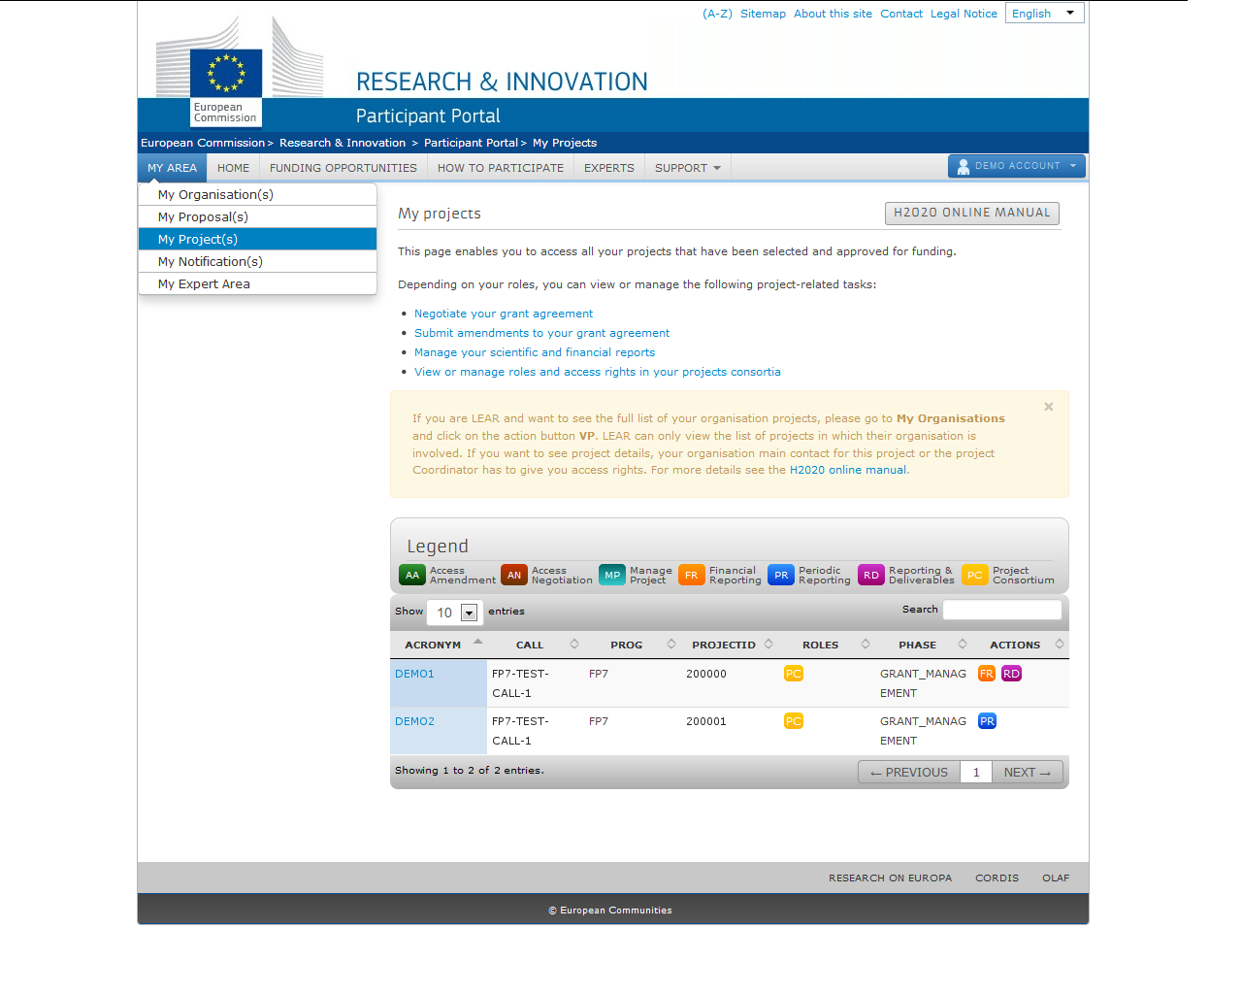
Project roles can be granted/revoked
in the "My Projects" section,
through the orange "PC (Project Consortium)" icon

Slide 16
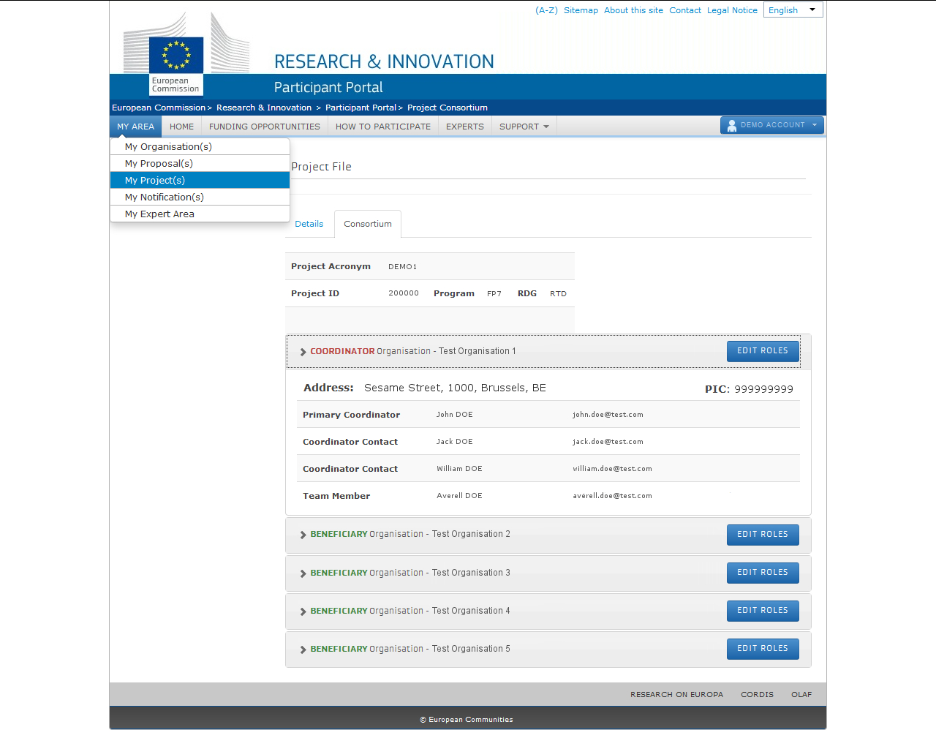
Edit roles - if you are Primary Coordinator Contact, Coordinator Contact or Participant Contact
View the organisation's basic details and list of project roles

Slide 17
Minimum configuration of access rights for running a project
✓ 1 Primary Coordinator Contact (CoCo)
✓ 1 Participant Contact (PaCo) per beneficiary
✓ 1 LEAR per organisation
✓ 1 Legal Signatory (LSIGN) per organisation
✓ 1 Financial Signatory (FSIGN) per organisation
One person (= one ECAS account) can cumulate an unlimited number of roles (e.g. owner of a one-person SME can be PaCo, LEAR, LSIGN and FSIGN at the same time)
Example: Consortium with 10 partners: minimum 40 roles for minimum 10 persons

Slide 18
The nomination process for LEARs – documents
LEAR appointment letter: http://ec.europa.eu/research/participants/data/ref/h2020/grants_manual/lev/h2020-lear-applet_en.doc
LEAR role and tasks: http://ec.europa.eu/research/participants/data/ref/h2020/grants_manual/lev/h2020-lear-roltas_en.doc
Terms and conditions of use of the electronic exchange system: http://ec.europa.eu/research/participants/data/ref/h2020/grants_manual/lev/h2020-lev-terms-of-use_en.pdf
Declaration of consent to the terms and conditions of use: http://ec.europa.eu/research/participants/data/ref/h2020/grants_manual/lev/h2020-lev-declaration-consent_en.doc

Slide 19
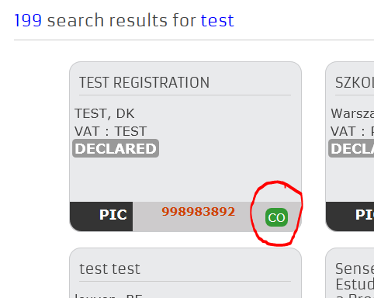
I do not know whether my organisation has a LEAR and - if yes - who it is
Go to the portal, search for your organisation, use the "Contact LEAR" function

Slide 20
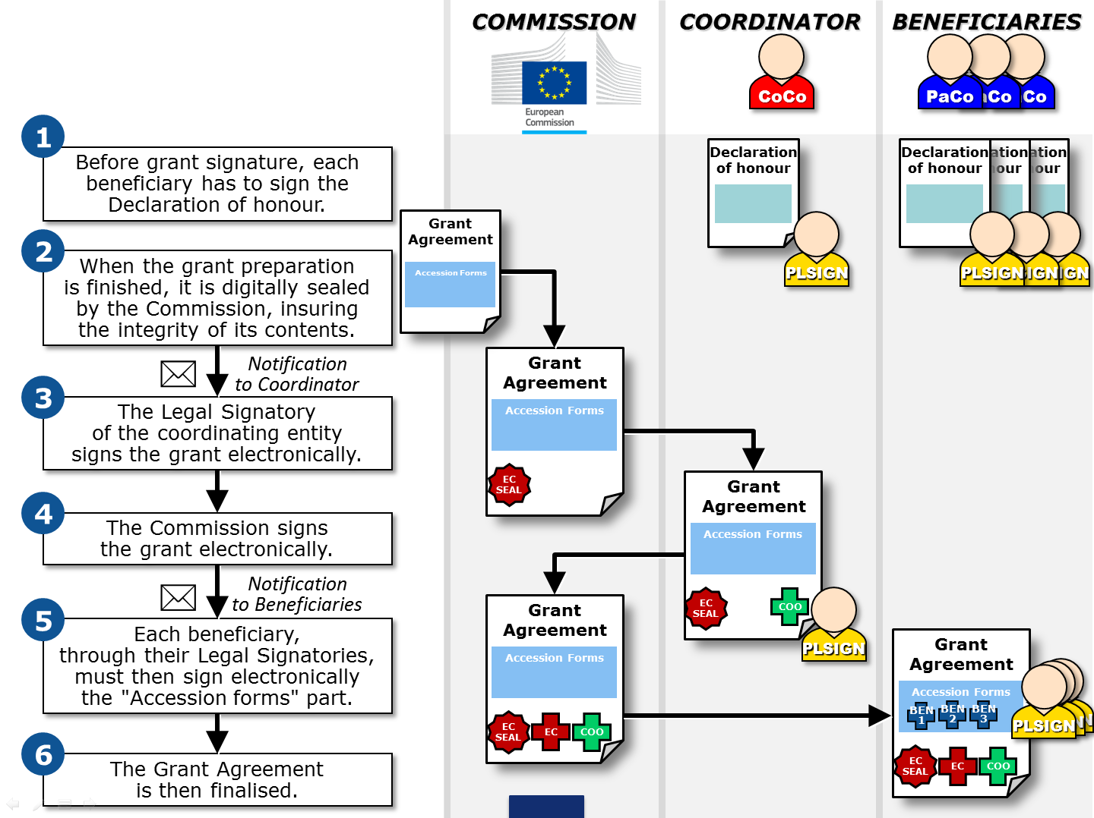

Slide 21
Grant management
Paperless submission: principles
LEAR nominates a list of persons authorised to sign
legal documents and financial statements
Only these persons get access to the "Sign and submit" function
in the appropriate tool
"Sign and submit" triggers the creation of an eReceipt
that is stored in the electronic project archive
All persons needing to know (including the LEAR) are notified
on the transaction and have access to the eReceipt

Slide 22
Value of the eReceipt
Electronic receipt = digitally signed PDF version
of the submitted document.
Both the content of the document and a set of metadata
(time stamp, ECAS credentials of submitter) are digitally sealed.
The digital signature mechanism, using a public-private key pair mechanism, uniquely binds the eReceipt to the transaction
and ensures its full integrity. Therefore a complete
digitally-signed trail of the transaction is available
both for the beneficiaries and the Commission.
Any attempt to modify the content will lead to a break
of the integrity of the electronic signature, which can be verified at any time by clicking on the signature in the PDF document.
The eReceipt is stored in the project archive where it can be downloaded at any time by any actor in the project and stored on other electronic media.

Slide 23
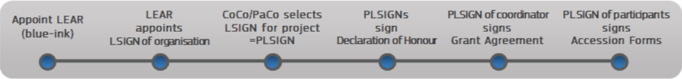
E-signature of grant agreements (1/2)
(Before GA signature, each beneficiary must sign declaration on non-exclusion – same signature process as described below)
COM prepares GA: pdf document, digitally sealed, made available in the PP. PLSIGN of the coordinator is notified.
PLSIGN of the coordinator logs in, selects project with "MP-Manage Project" action button, finds GA for signature (with possibility to download and print).
PLSIGN clicks for initiating electronic signature. Pop-up alerts on the signification of this action and asks for confirmation, prompting again for the ECAS password.
PLSIGN reintroduces ECAS password and clicks ‘Sign”.

Slide 24
E-signature of grant agreements (2/2)
System creates new version of the pdf, addingthird party digital seal, ECAS credentials of the signatory, timestamp; visually replacing the placeholder for the signature by the coordinator.
LEAR of the coordinator and other relevant actors are notified
COM authorising officer is notified that GA was signed by the coordinator.
Following a similar procedure as under 2) to 6), COM authorising officer signs the GA.
PLSIGNs of all other beneficiaries are notified that GAis ready for their accession.
PLSIGN of each beneficiary signs (see 2) to 5)) accession form
LEARs of the beneficiaries having signed the accession form and other relevant actors are notified.

Slide 25
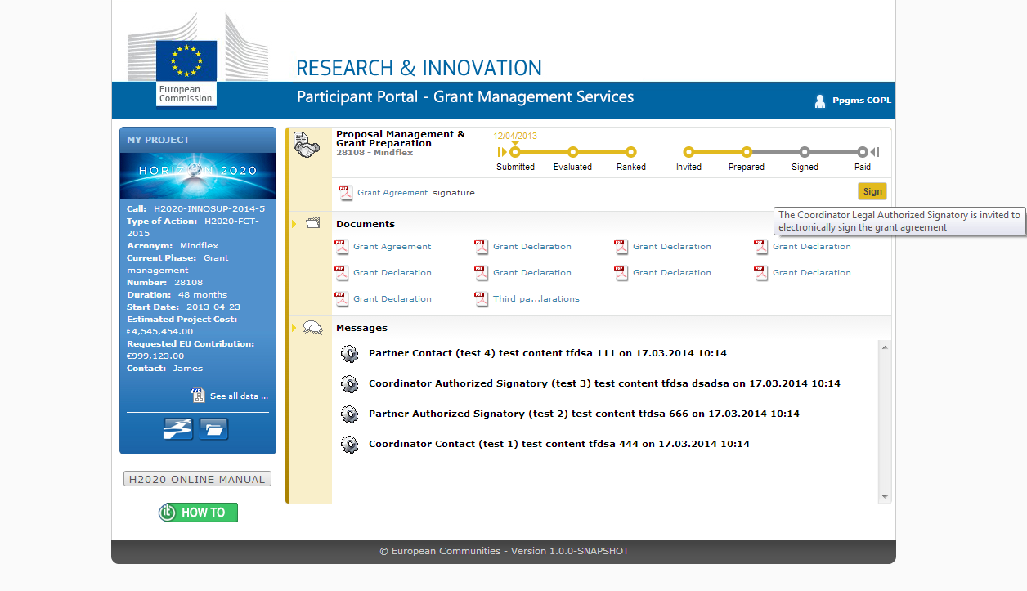

Slide 26
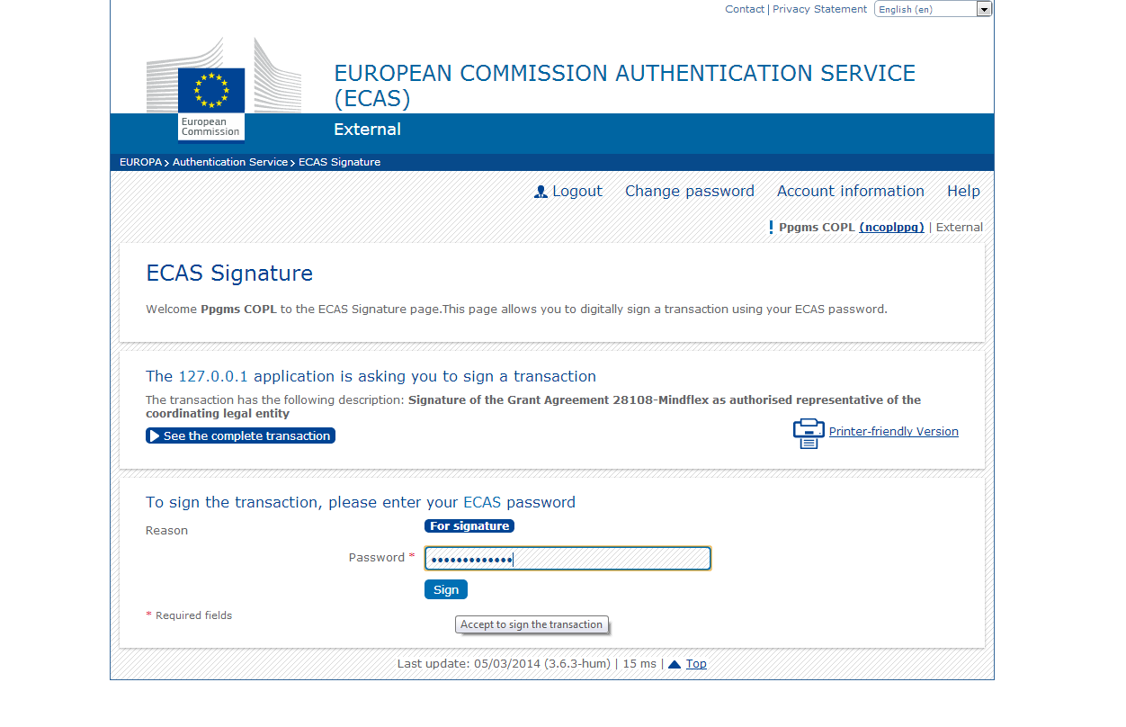

Slide 27
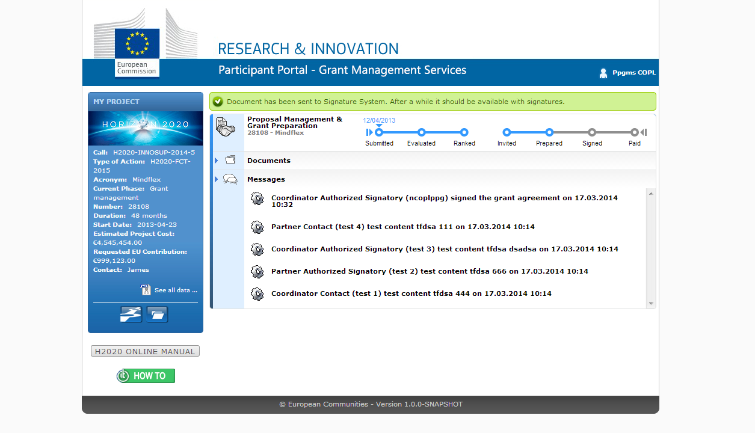

Slide 28
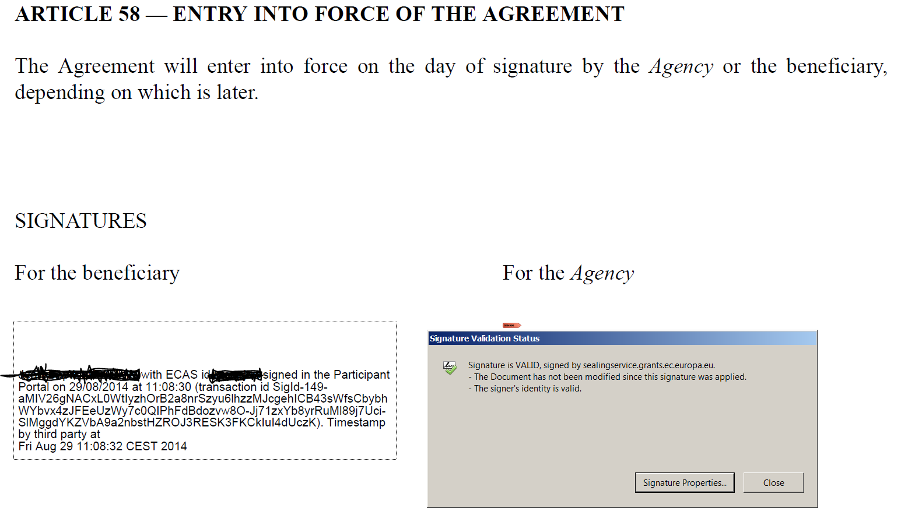

Slide 31
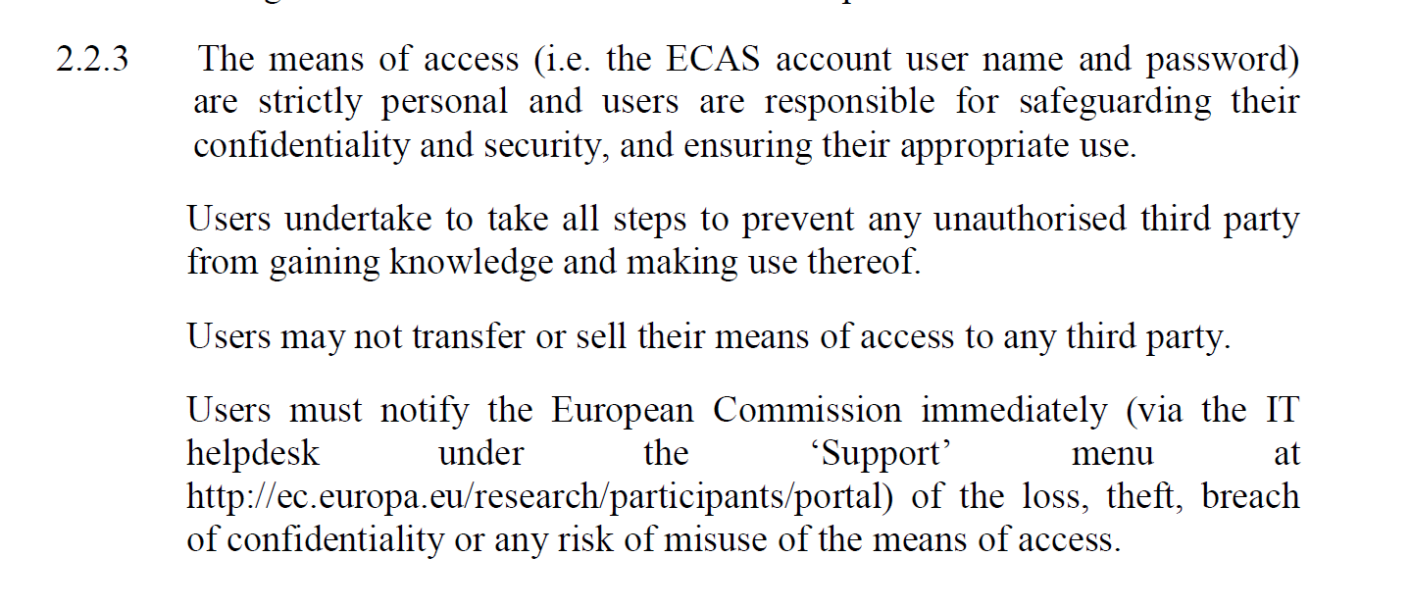
Terms of use

Slide 32
Where to find help?
How to Participate
H2020 Online Manual
  New online guide divided into business processes
  Aims at providing all the information, list of documents
  & useful links (IT wiki, etc.) for each specific process
  2 ways of finding info:
  General overview with drill-down approach
  Direct linking to specific sections from some Participant Portal pages (via the "H2020 Online Guide" button)
IT HOW TO
  Videos about the given IT tool
  Step by step descriptions
  Full user guides with all details

Slide 33
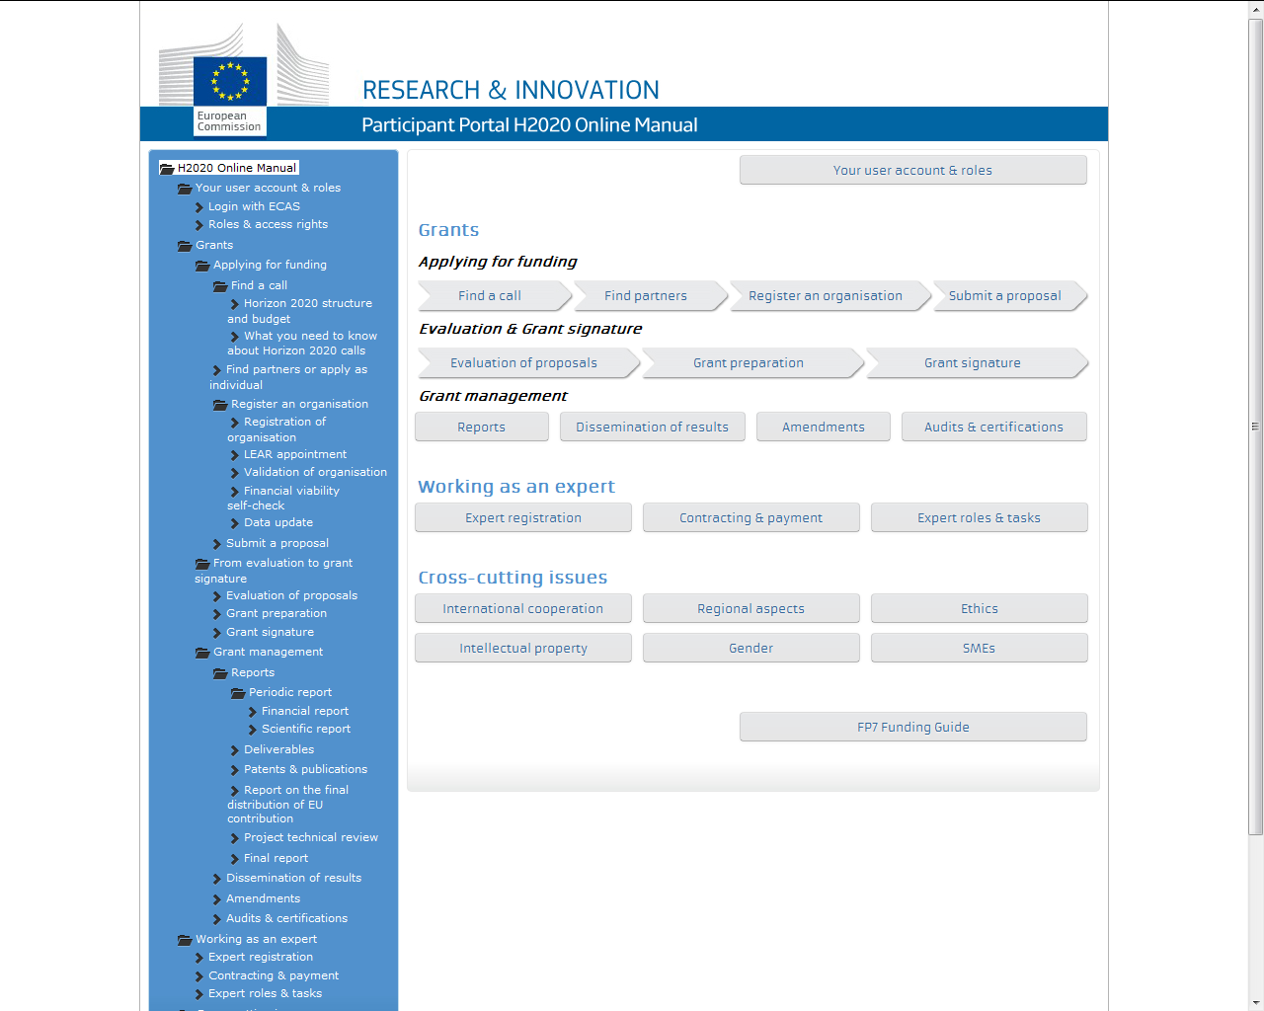
Find guidance, process by process (drill-down approach)

Slide 34
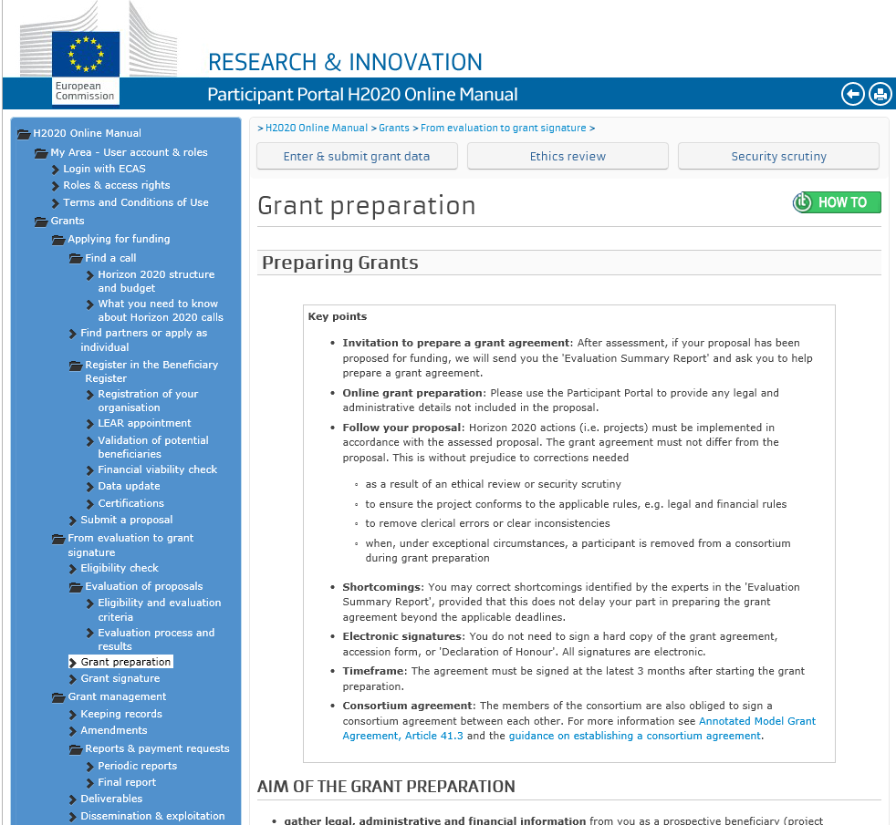
Find more help about the related IT tool

Slide 35
Documentation and guidance
Online manual, sections on roles, grant signature and LEAR appointment
Terms and conditions of use
Video on e-signature
Video on LEAR appointment

Slide 36
Many thanks for your attention!
More:
http://ec.europa.eu/research/participants/portal

