Slide 1


The Grant Agreement Preparation - an overview
H2020 Horizon 2020 Coordinators' Day
Brussels, 08/SEPT/2015
Alan HAIGH
Innovation and Networks Executive Agency (INEA) – Head of Department Horizon 2020
Deputy Business Process Owner 'H2020 Grant Management'
"The views expressed in this presentation are those of the author and do not necessarily reflect the views of the European Commission"

Slide 2

Grant agreement preparation (GAP) in H2020
H2020 GAP – the process overview
Key novelties – what's new
Highlights and tips

Slide 3

The Family
REA
EDCTP 2
EIB
CHAFEA
ERCEA
P2Ps
EMPIR
AAL 2
EAs
COMM
AGRI
EACEA
EASME
EURO
STARS 2
DEVCO
MOVE
ENTR
JRC
EAC
INEA
ECHO
RTD
SANCO
CLIMA
CNCT
IMI
2
MARE
ENV
ENER
ECSEL
FCH
2
PPPs
EIT
Shift
2
Rail
Clean
Sky
2
SESAR
2
BBI

Slide 4

H2020 GAP – the process overview
fully electronic process
Invitation to grant preparation
harmonized rules
uniform interpretation
standard processes
Grant signature
e-signature
Evaluation
Grant Agreement Preparation (GAP)
Pre-financing
a time-bound process
Accession GA
committed to make it simpler and quicker

Slide 5
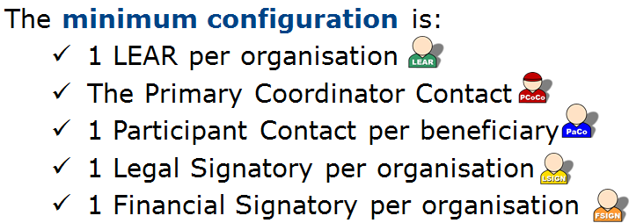
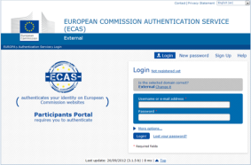
Electronic-only grant management
E-only: paper-free process endorsed by e-signature
Based on a "chain of trust" enabling e-signature
Identity and Access Management (IAM)
Roles enabling e-signature

Slide 6
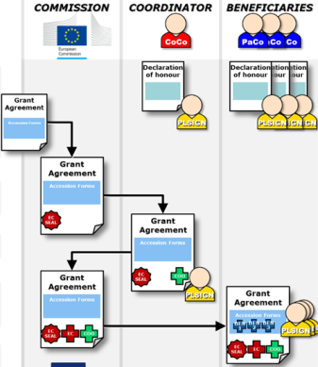
E-signatures on GAP
Declaration of honour
The Grant Agreement
Accession Forms
the coordinator and each beneficiary,
signed by the LSIGN
- first the coordinator, by the LSIGN
- second the EU EC/Agency
each beneficiary - by the LSIGN

Slide 7
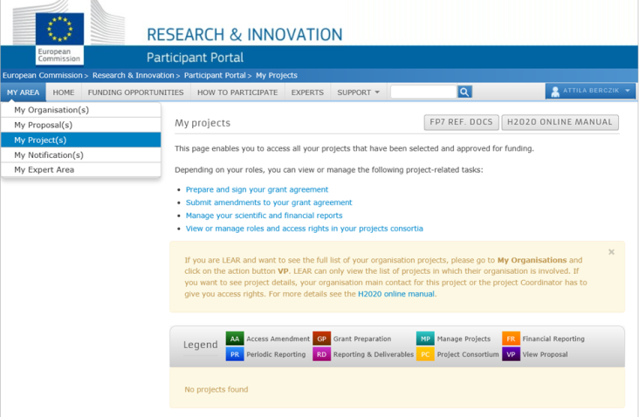
IT system suite for grant management:
Fully integrated into the Participant Portal

Slide 8
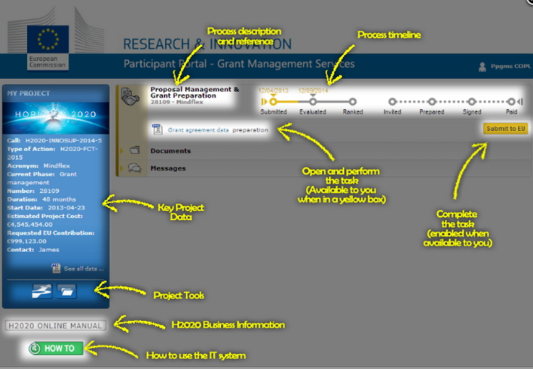
IT system suite for grant management:
Participant Portal Grant Management Service (PPGMS)

Slide 9
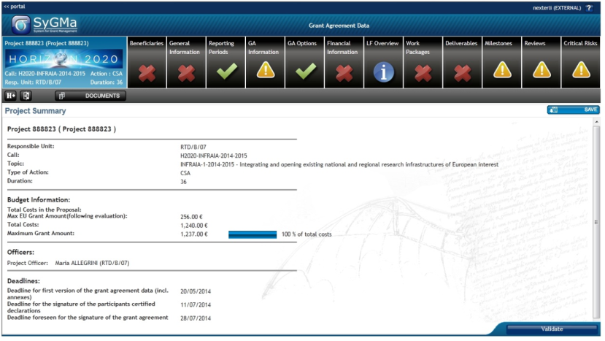
PPGMS

Slide 10
time-bound process
Call deadline
Invitation to grant preparation
Grant signature
submission
Proposal Evaluation
Grant Agreement Preparation
Pre-financing
5 months maximum
Accession to GA
8 months maximum
Maximum five months from call closure date - until the date of informing applicants about the outcome of proposal evaluation
Maximum eight months from call closure - until the signature of the grant agreement

Slide 11
no-negotiation
Your proposal is taken "as is"
The Grant Agreement (GA) is prepared on the basis of the proposal selected for funding
Proposals are evaluated on their merit and not on their potential
BUT this does not mean "no change at all"
    Changes to meet legal and/or financial requirements (eligibility)
    Changes that are necessary:
    Requirements resulting from ethics review or security scrutiny
    Due to removal of a participant (if agreed)
    Correction of clerical errors and obvious inconsistencies

Slide 12

E-only grant management: more is on offer now
Amendment module is available
- 200 are already completed and other 240 on-going,
- More than 4.000 fully automated information procedures*
* for changes which do not require amendment: e.g. change of address. See PP H2020 Online Manual
Reporting module is live
- ~ 800 continuous reports (project deliverables) submitted,
- ~ 300 periodic reports launched

Slide 13

… and some KPI metrics
As of today
More than 5.120 H2020 grant agreements e-signed
>> for more than 7.358 million EUR EU contribution
for 18.200 participating beneficiaries
Other 1.540 GAs are under preparation
26.000 unique users of the IT system (August '15)
320.000 electronic documents stored in e-repository
Time-to-Grant (TTG) period – 8 months from call closure to GA signature: 97% of grants signed within

Slide 14

Thank you

